Slide 1

Expenditure Data Analysis Internship
By : Sohel Datta

Slide 2
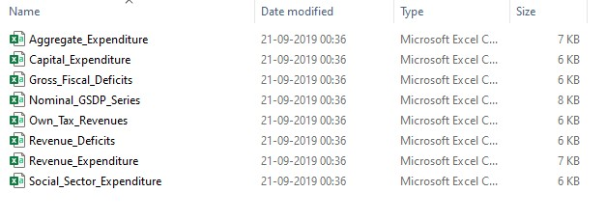
About Dataset:
The dataset as listed on NITI Aayog website from 1980_81 to 2015_16.
You can find the dataset on the given link. https://www.niti.gov.in/ (https://www.niti.gov.in/)
Over raw dataset contains 8 table as category wise

Slide 3
Objective:
To run government, it is important to manage expenses. It’s a way by which any government can handle its economy.
So, in this project we are going to analyze some key features that describes, how well a state government is in managing its economy as a categories of expenditure.
This will helps management in creating and establishing new structure and models to reduce cost , high cost s not good at all.
For this purpose, we will get our dataset from NITI Aayog from 1980-81 to 2015-16.
The NITI Aayog is developing itself as a state-of-the-art resource centre with the necessary knowledge and skills that will enable it to act with speed, promote research and innovation, provide strategic policy vision for the government, and deal with contingent issues.

Slide 4
Benefits:
To monitor government expenses of all categories.
To have more precise financial and annual report state wise.
To manage cost for future allotment.
To improve overall performance.

Slide 5
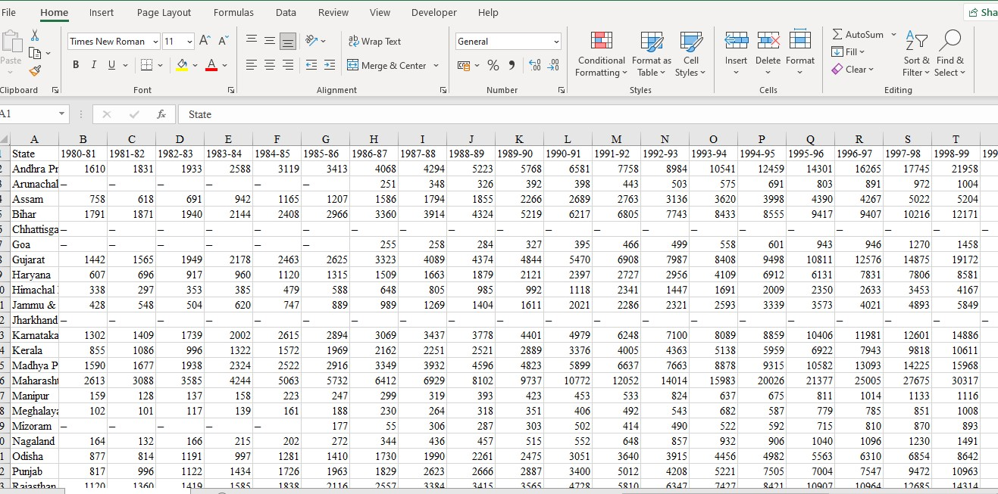
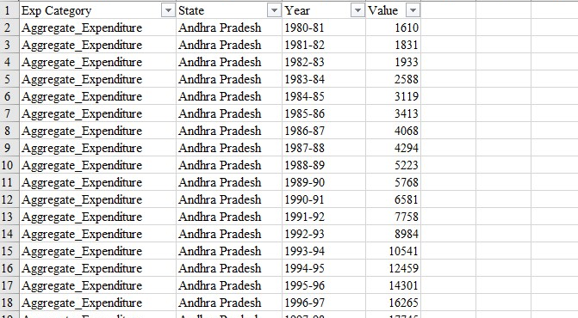
Data Preparation:
In the Preparation Process, we will convert our original datasets with other necessary attributes format.
Reconstruct the structure of the dataset.
Unpivot it in MS excel with Power query editor.
Cleaning dataset: Removing blanks, dashes and “p” replacing with 0.
Fig: Unstructured to stricture dataset

Slide 6
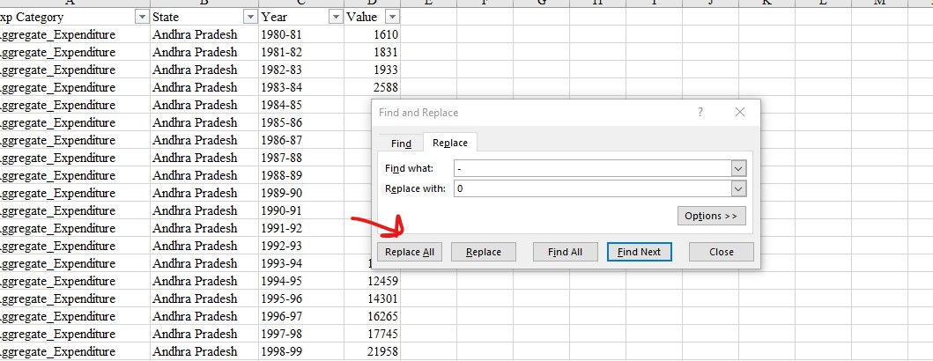
Data Validation:
Dataset contains blanks,’-’ and ‘p’ replacing all with 0.
In years column some data points have extra text. To removed using
Formula “=Left (C2,7)” and apply it for whole column

Slide 7
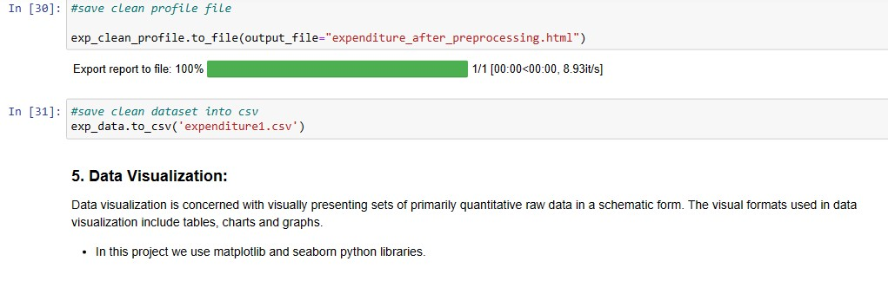
Export Data from Python
Perform Exploratory Data Analysis Using Python:
Import Python Modules
Load Dataset
Data Preparation
EDA: Data Visualization
Fig: Extracting cleaned dataset

Slide 8




Architecture:
Data Transformation
Data Cleaning
Data Visualization
Development
Unpivoting dataset
Removing blanks and duplicated rows
Making Insightful Dashboard
Publishing
dashboard
Fig: Architecture of process and tools

Slide 9
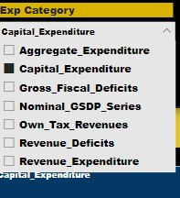
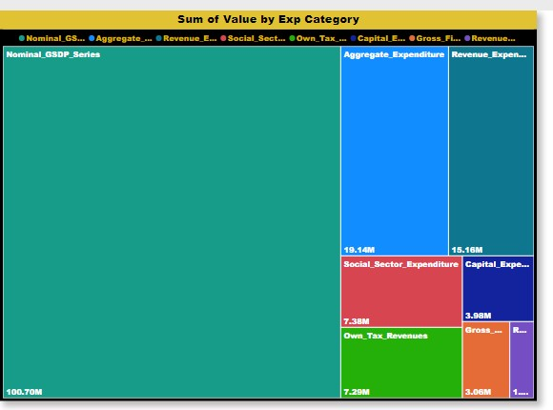
Development:
1. Power BI: Creating Dashboard
Load cleaned dataset on Power BI and creates visuals for dashboard.
After creating all visual, create insightful dashboard.
Fig: Slicer and tree map for expenditure category

Slide 10
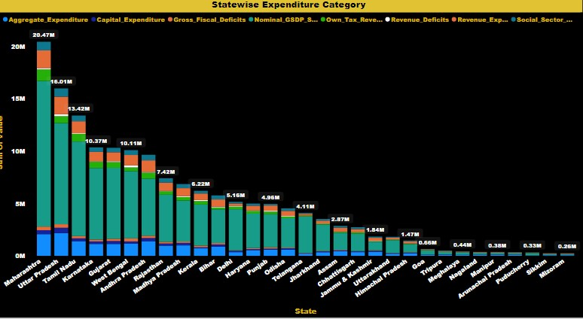
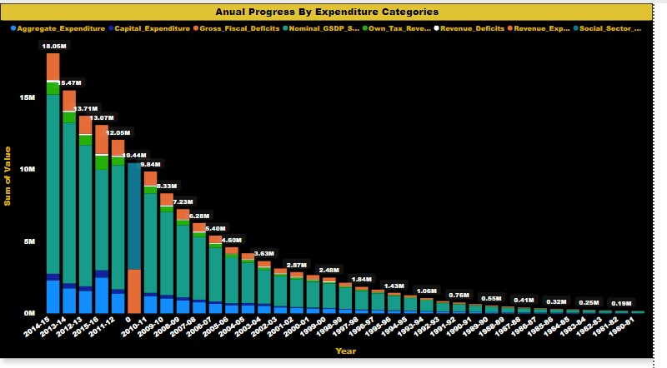
State wise and annual report in stack column charts
Fig: State wise and annual report in stack column charts

Slide 11
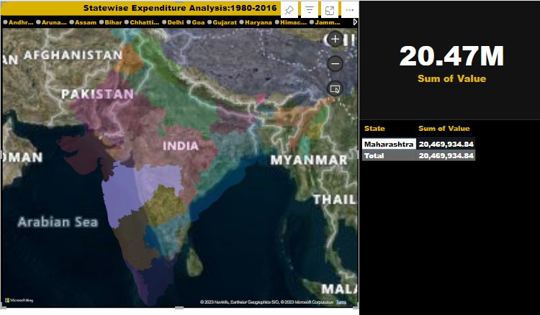
Creating map for states wise analysis
Values shown in card.
State name and corresponding expenditure value in table
Fig: state wise expenditure analysis

Slide 12
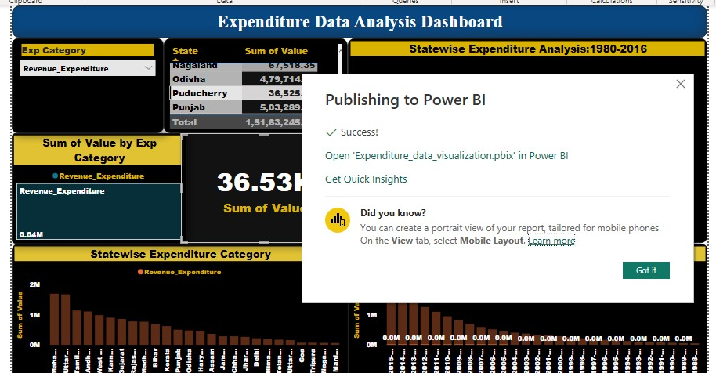
2. Power BI Online: Publish Dashboard
Then Login into Power BI Service by using Microsoft developer account.
Then create new project workspace for uploading dashboard and reports into this workspace.

Slide 13
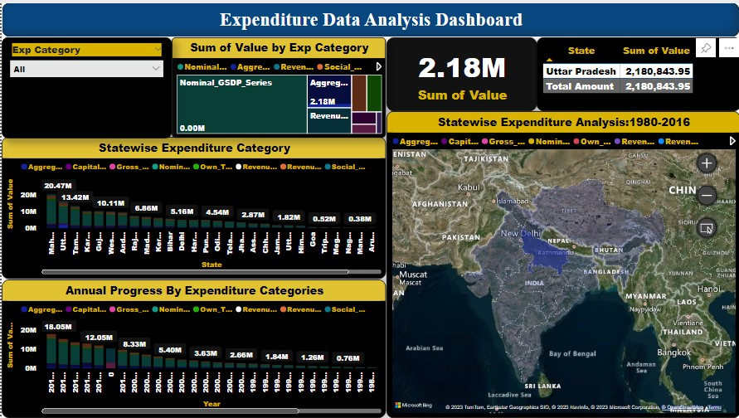
Final Dashboard:

Slide 14
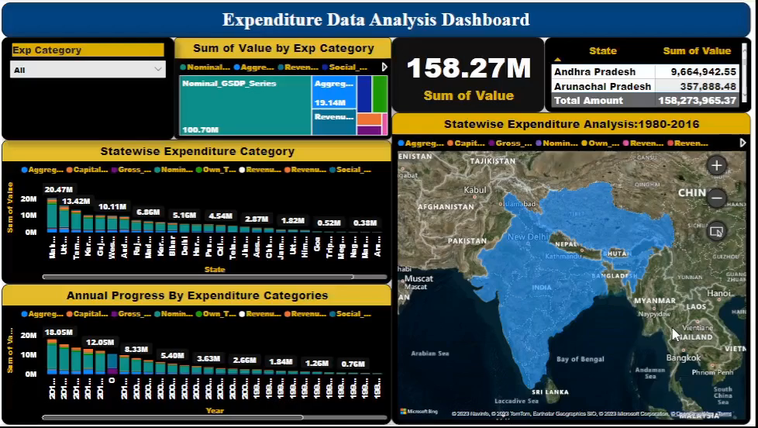

Slide 15

Thank You!

